Slide 1
Shadow mapping
INFO-6020 “Graphics 2”

Slide 2
Few general kinds
Flattened geometry
Stencil buffer based
Bit-mapped (several kinds)

Slide 3
Flattened geometry
Flatten the geometry along the “ground” axes
Draw it in a dark (“shadow”) colour just below the object and just above the “ground”
You can even change the size based on distance from the “ground”
Only works in certain situations.
Very simple, effective, and fast
Doesn’t even have to be the shape of the model: can be a circle and people won’t even notice

Slide 4
Stencil buffer based
The stencil buffer can be used to isolate parts of the screen when being drawn – like a “was drawn” or “not drawn”
Then based on this info, a later draw pass can read this information.
But values in the buffer don’t have to be binary: they can be a set of flags or a counter.
If used as a counter, it can also keep track of which “side” of the object has been drawn.
If you draw both sides of the object and increment when facing one way, and decrement while facing another way, you can determine if the stencil has the “back” part of the model.
On the next pass, you can read the stencil and see if the object is in shadow

Slide 5
Stencil buffer based
Advantages:
Very fast
Somewhat straight-forward
Disadvantages:
Model can’t have any “cracks” or spaces between parts (which is difficult) If there are any, you get seriously ugly, noticeable effects.
Tricky to determine which direction the light is coming from.
One pass per light.
Tricky to combine shadows (if they get darker with more shadows, I mean).
Shadows can only have hard edges. (and edges don’t change based on distance)

Slide 6
Bitmap based: General idea
Use the depth buffer to store the location of the object from the view of the light (that is casting a shadow)
On the next pass – from the camera’s view – compare the depth of the vertex that the camera sees with the depth of that vertex from the light pass depth.
If that vertex is farther than that corresponding location in the light’s depth buffer pass, then it’s in shadow
In other words, there is something else that set the depth closer according to the light’s view.
Otherwise, the object is being lit by that light.

Slide 7
Bitmap based: Pros/Cons
Pros: Looks reasonably good. Reasonably fast.
Cons:
Have to deal with normalized device coordinates (usually)
One pass per light
Have to be careful with resolution and depth planes to maximize the quality of the shadow
With angled lights, objects closer to the light appear less pixelated.
“Peter Panning” issues: edge of object doesn’t match edge of shadow (precision issues, etc.)

Slide 8
Bitmap based: Variations
Directional light:
Single 2D bit map from single, directional light.
Uses orthographic projection for light.
Cascaded shadow maps:
Same general technique, but different depth buffers are used at different distances, reducing precision artifacts for close objects
Point light:
Cube map rather than single 2D map.
Trickier to make looking good.

Slide 9
Bitmap shadow

Slide 10
FBO, only depth
We want to render from the light’s perspective, but we only need the depth buffer information.
Basically, we’re making an off-screen texture, but only saving the depth – or we only “care” about the depth.
Note that the depth buffer isn’t linear and the “colour” that is stored is tied to the near and far planes being used.
What’s really happening is that the value that is saved in the depth buffer is related to the near and far plane: the larger this difference, then lower the resolution of the depth value.

Slide 11
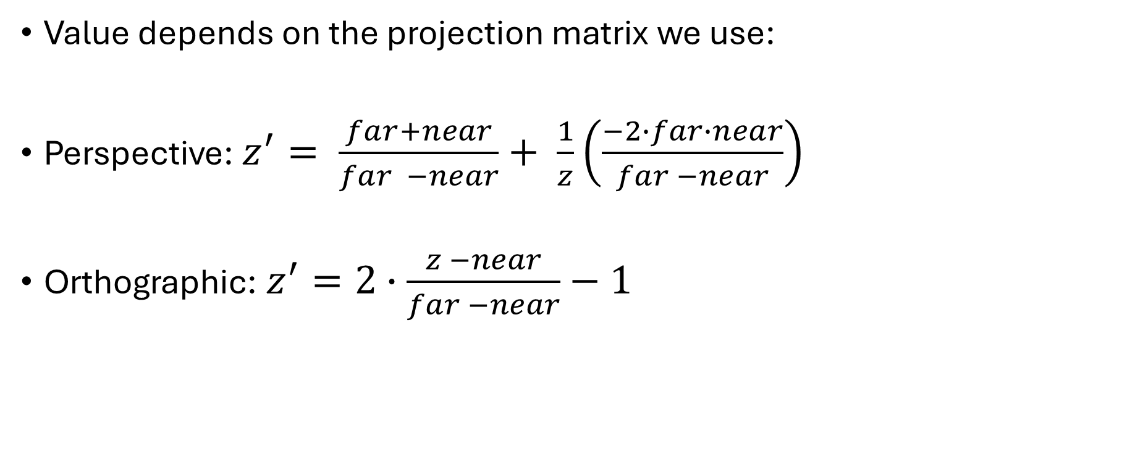
Z/depth-buffer
Value depends on the projection matrix we use:
Perspective: $z^{′}= \frac{far+near}{far −near}+ \frac{1}{z}\left(\frac{−2∙far∙near}{far −near}\right)$
Orthographic: $z^{′}=2∙\frac{z −near}{far −near}−1$
From: https://en.wikipedia.org/wiki/Z-buffering

Slide 12
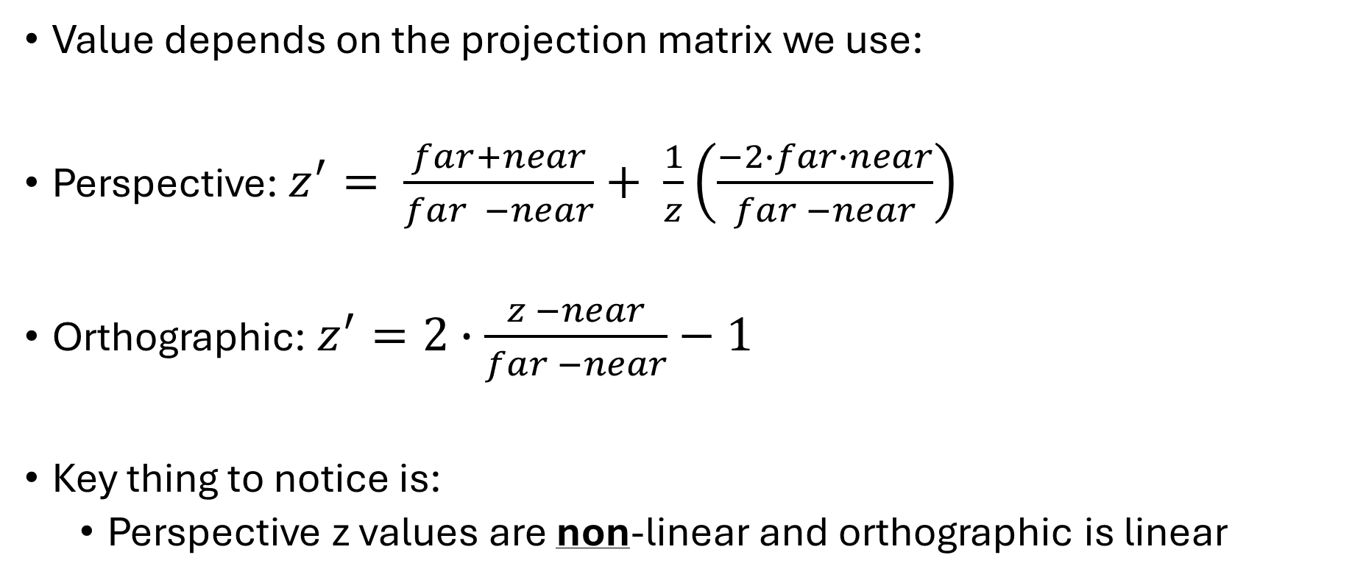
Z/depth-buffer
Value depends on the projection matrix we use:
Perspective: $z^{′}= \frac{far+near}{far −near}+ \frac{1}{z}\left(\frac{−2∙far∙near}{far −near}\right)$
Orthographic: $z^{′}=2∙\frac{z −near}{far −near}−1$
Key thing to notice is:
Perspective z values are non-linear and orthographic is linear

Slide 13
Z/depth-buffer
Perspective: non-linear; orthographic: linear
Why is this an issue?
If we are using the same projection for both then it’s not (an issue)
For directional lights, you use an orthographic projection
For point/spot lights, you use a perspective projection
But even if we use the same projection (say perspective for camera and a spot light), the values are usually different.
Particularly the near and far planes

Slide 14
Normalized Device Coordinates (NDC)
We’ve been ignoring it, but in order to simplify clipping, all vertex locations are transformed to a box that’s 2.0 units on each side, from -1.0 to +1.0 on each axis. Anything outside this box is clipped (removed) and not displayed.
Again, we usually don’t really care.
With bitmap shadows, we are comparing distance values that have been generated by different projections.
But if we compare these distances in NDC, this can help

Slide 15
The steps:
Create a depth only FBO (frame buffer object) and draw the scene from the light we want to cast a shadow.
Keep the near and far plane as close together as possible
If it’s a directional light, use an orthographic projection
If it’s a point/spot light, use a perspective projection
Be careful with the view frustrum/viewport to fit only the part of the scene we want: make it as small as possible.
The more “shallow” the angle of the light, the more artifacts we will have.
There is a trade off between shadow texture resolution and quality.

Slide 16
The steps:
Create a depth only FBO (frame buffer object) and draw the scene from the light we want to cast a shadow.
A “complete” FBO requires a colour buffer, so if we aren’t using it, we can tell OpenGL that by:
glDrawBuffer(GL_NONE) ← tell which colour buffers we are drawing to
glReadBuffer(GL_NONE) ← tell which colour buffers we are reading from (for alpha transparency, for instance
With both set to GL_NONE, we are saying we aren’t touching the colour buffer

Slide 17
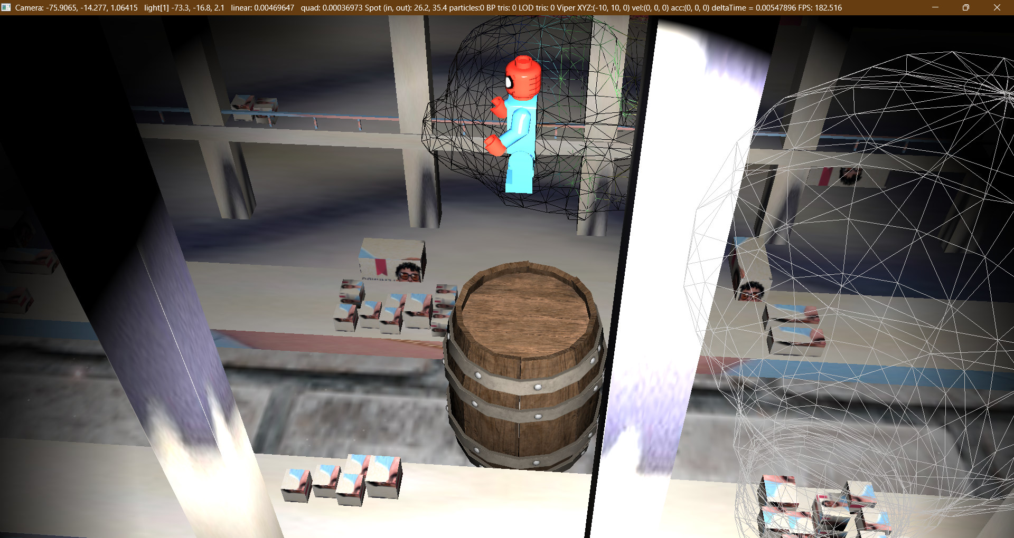

Slide 18
The steps:
Render the scene from the camera’s viewpoint.
During this pass we also calculate the vertex location from the look at transform we used in the “light shadow” pass.
We take the depth that THIS vertex (i.e. the camera’s view) is in the LIGHT’s pass and compare the two depths:
If the CAMERA depth/distance is LARGER than the corresponding location on the LIGHT depth buffer, then that vertex is in shadow.
i.e. something from the CAMERA’s view is CLOSER than the vertex the CAMERA is seeing.
Otherwise, it’s being lit

Slide 19
Purple is the depth information from the view of the light.
(You’ve done a render pass by putting the camera at the light, looking at wherever it’s looking at).
This is perspective view.

Slide 21
The issues:
Depending on your projection:
Depth buffer is linear (orthographic) or non-linear (perspective)
It’s almost always a different size than the main colour buffer
In the previous diagram, BOTH depth buffers will have a range from 0 to 1, and any “world” coordinates (actually screen coordinates) will be set to NDC, with a range of -1 to 1.
The issue?

Slide 22
Distance of 0.5
Distance of 0.5
Say the “distance” from the vertex to the light is 0.5 and coincidentally the distance from the camera to the same vertex is ALSO 0.5. Unless the projections were identical, you CAN’T compare them

Slide 23
The issues:
Projection from light:
Near: 0.1f
Far: 200.0f
Which means that in the depth buffer:
0.0 is 0.1 units from the light and
1.0 is 200.0 units from the light
Projection from camera:
Near: 1.0f
Far: 50,000.0f
Which means that to the camera depth buffer:
0.0 is 1.0 unit from the camera
1.0 is 50,000.0 from the camera
0.5 = 100 (linear)
0.5 = 25,000 (linear)

Slide 24
Rules of thumb:
Draw the back of the objects (if there are backs…) when doing the shadow map generation
You can use a polygon offset value (pushing the depth buffer from the light just slightly back) to help with the floating point error
This leads to “peter panning” – Edge of the shadow disconnects from the edge of the object – about the same amount as the offset value.
Clamp the edge of the shadows to the maximum depth

Slide 25
Cascading shadow maps
We did something like this before:
Say we want the control panels that are right in front of us in focus AND we want to see stuff REALLY far away.
One projection matrix: N: 0.001f – F: 100,000,000
But that’s not going to work
Make more than one:
Render scene with N:F (0.001: 10.0)
Render scene again N:F (1,000: 100,000)

Slide 26
Cascading shadow maps
Same concept where there are layers of shadows at different depths/distances from the camera
You need to add additional information when sampling from the shadow map to see which “layer” you are in
Microsoft DirectX has some excellent articles:
https://learn.microsoft.com/en-us/windows/win32/dxtecharts/cascaded-shadow-maps
https://learn.microsoft.com/en-us/windows/win32/dxtecharts/common-techniques-to-improve-shadow-depth-maps
The Source Engine (Counter strike) does this: https://developer.valvesoftware.com/wiki/Env_cascade_light

Slide 27
Point lights
If you want a point light in the centre of a scene, for example
You can do the same sort of thing, but generate a cube map instead of a 2D texture.
This is much more involved.
The “trick” is to use the geometry shader to generate more than one output (view) at a time.
gl_Layer: https://registry.khronos.org/OpenGL-Refpages/gl4/html/gl_Layer.xhtml

Slide 28
Stencil buffer

Slide 29
Stencil buffer
Usually an 8 bit buffer that we can write to and read from.
Can also control if we write and what we write
Usually disabled: glEnable(

